Slide 1


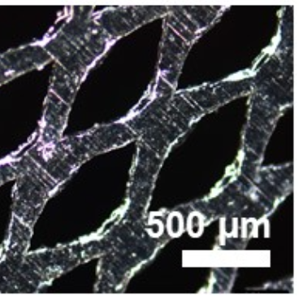
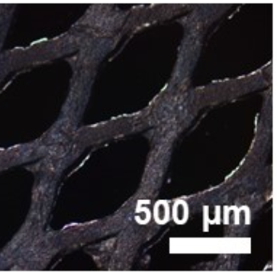
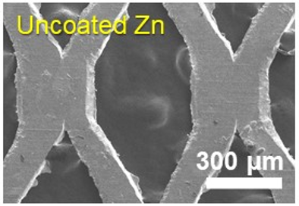
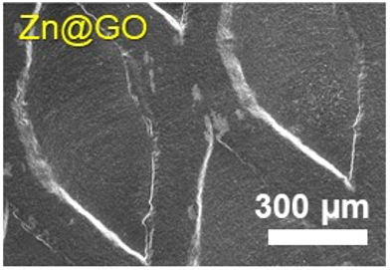
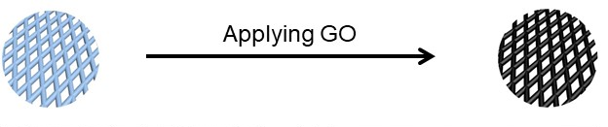

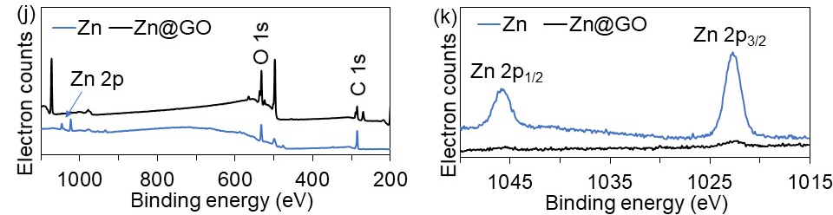
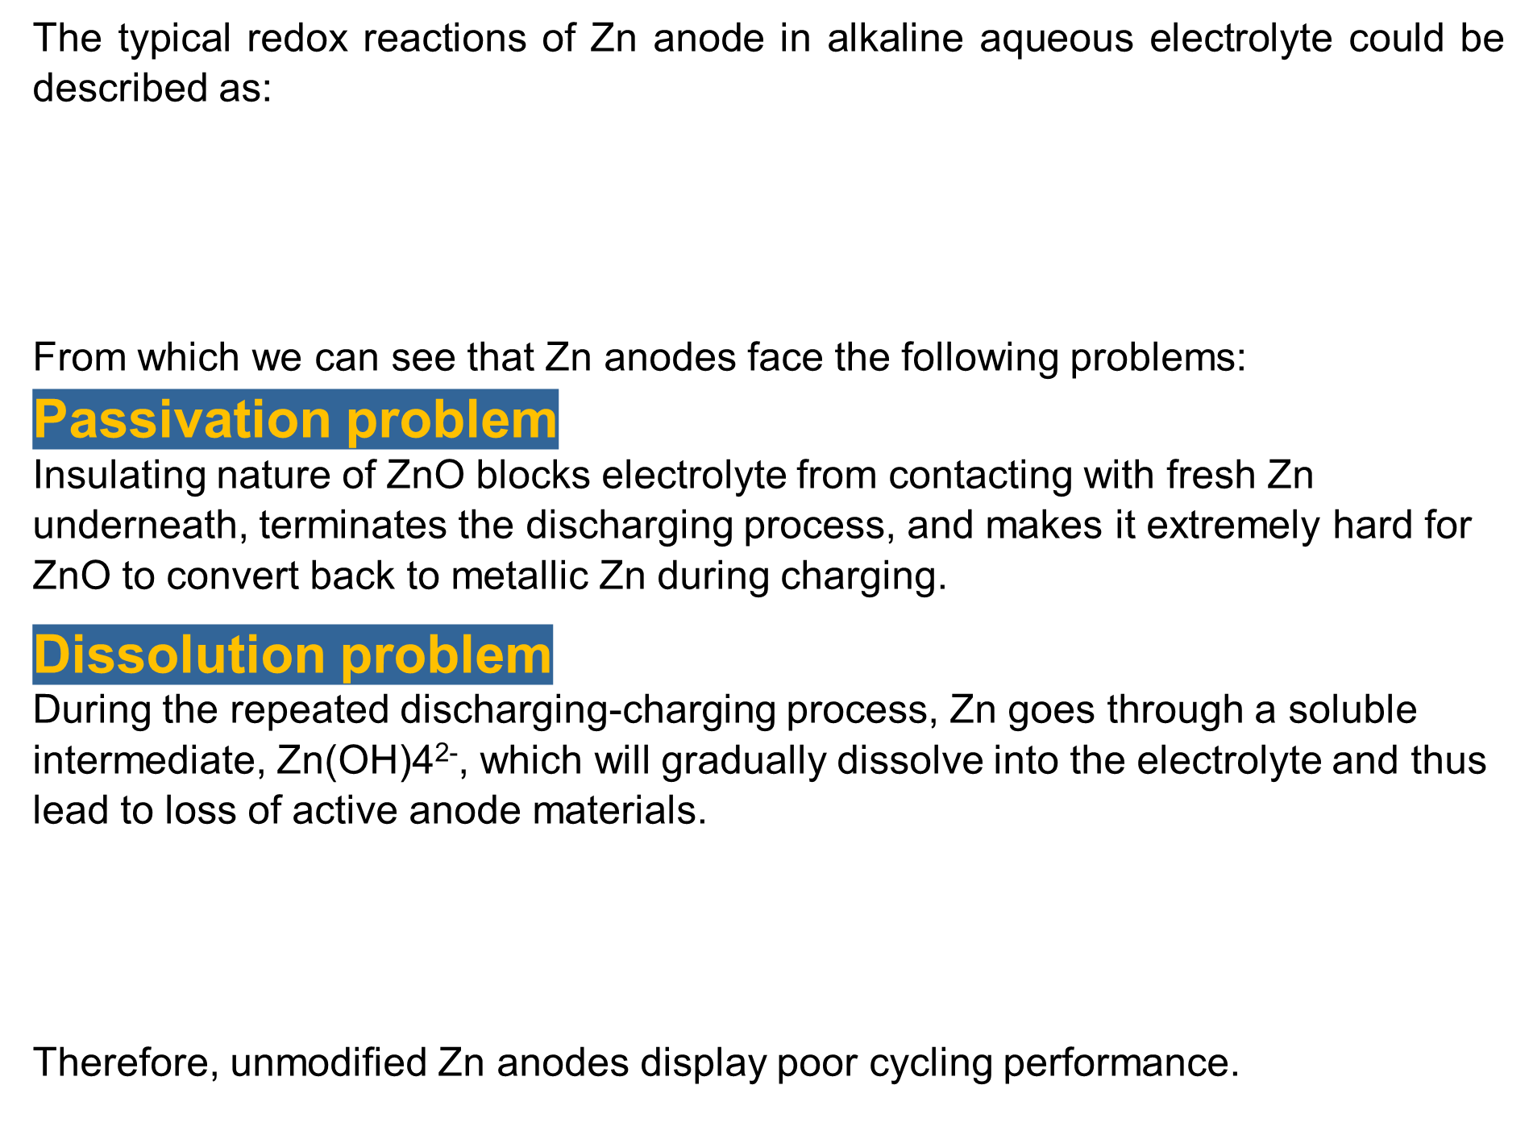

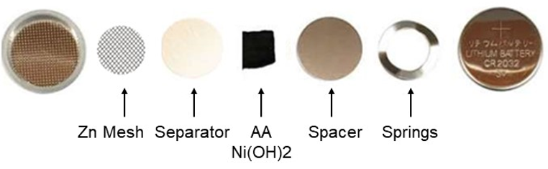
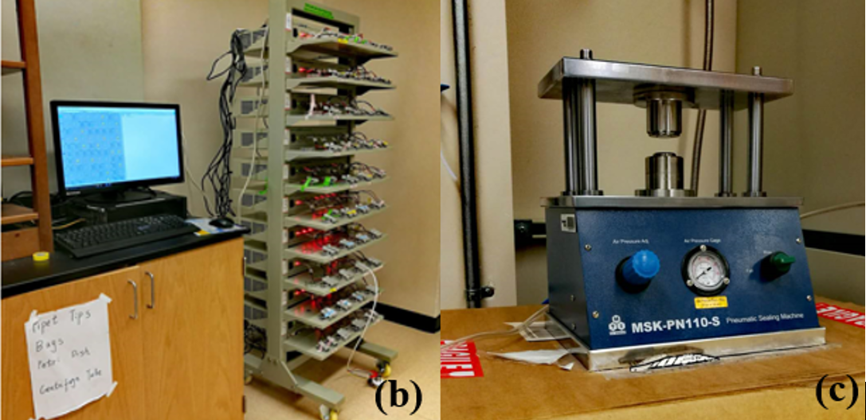
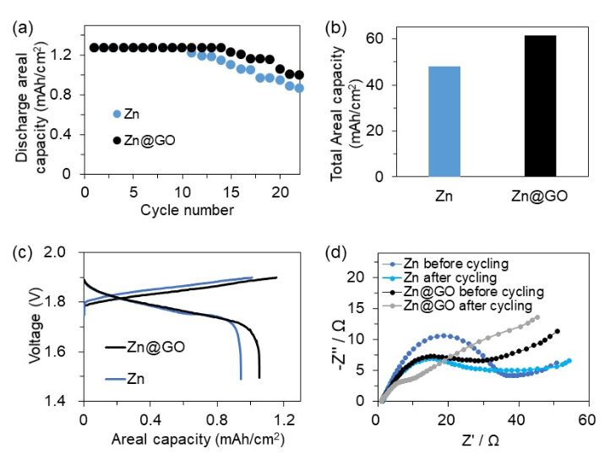
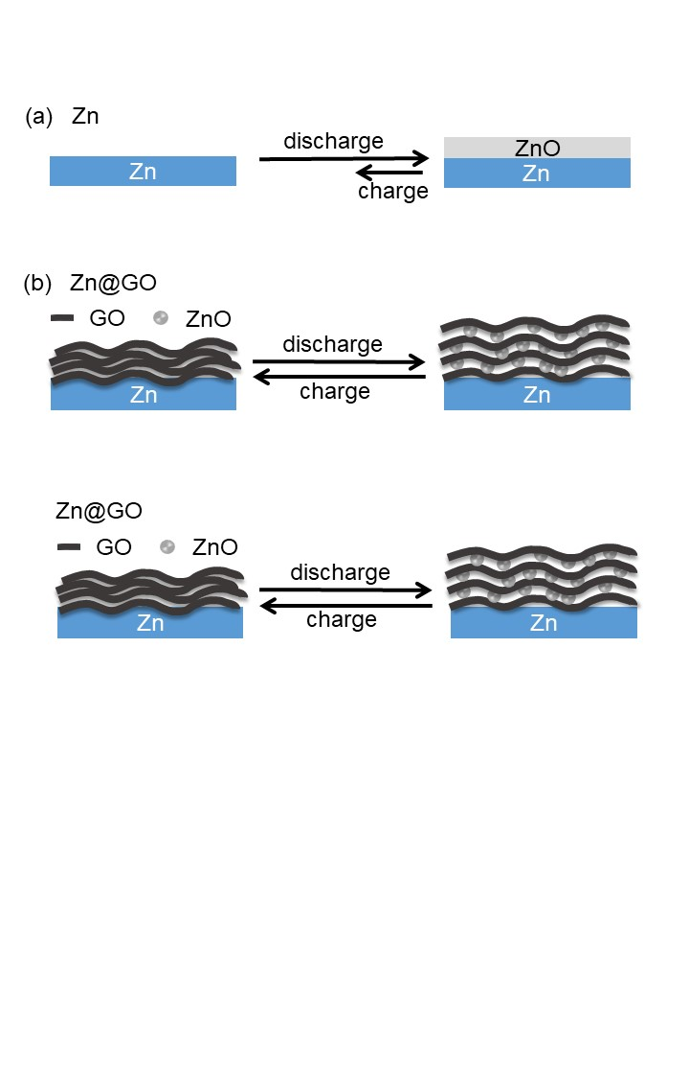
Graphene oxide-modified zinc anode for rechargeable aqueous batteries
Challenges
Start with G, does not work?
Apply GO uniformly
Personally: get familiar with procedures
Unstable data?
Highlights
Fabrication of Zn@GO anodes
Material characterization
Zinc is a promising anode for high energy aqueous batteries, yet its rechargeability is poor.
Graphene oxide was uniformly coated onto zinc anode.
Graphene oxide coating suppresses dissolution and passivation problems of zinc anode.
Graphene oxide-modified Zn metal anode shows enhanced rechargeability and surface charge transfer property.
GO/water binder slurry was prepared by mixing 2.1 mg GO powder, 2.4 mg water binder, and 160 μl water in a glass vial under sonication for 60 min and then stirred for 1 day to ensure thorough mixing. Zn mesh was cut into round disks with 1 cm diameter and then weighed. After that, GO slurry was applied twice onto surface of the Zn to obtain a uniform GO-modified Zn surface. Finally, the GO-modified Zn mesh was dried at room temperature in air for 1 day.
To evaluate the electrochemical performance of GO-modified Zn anode, Ni cathodes harvested from commercial Ni-Zn AA batteries were used as the rechargeable cathode. Before cell assembly, Ni cathodes were oxidized to 0.6 V vs HgO/Hg reference electrode in a beaker cell to completely turn Ni(OH)2 to NiOOH. The reversible redox reaction of the cathode is:
The coin-type batteries were assembled using：
CR2032 cases (MTI Corporation)
Zn mesh anodes or Zn@GO anodes (round disk, 1 cm diameter)
Glass fiber as the separator, with 50 μL electrolyte (4 M KOH, 2 M KF and 2 M K2CO3)
NiOOH cathodes with excess capacity
An MSK-110M hydraulic sealing machine
Optical and SEM images show that GO has been coated onto Zn anode uniformly:
Uncoated Zn
Zn@GO
Advantages of Zn anodes
Results
Preparation of Ni cathodes
Here we report a GO-modified Zn anode to solve the passivation and dissolution problems of Zn anode. A small amount of GO (2.5 wt%) on the Zn anode surface can improve its accumulated capacity by 28%.
The complete coverage of Zn by GO is supported by XPS results (Fig. j and Fig. k), where Zn signal is barely detectable from Zn@GO.
Discharge areal capacity of the first 22 galvanostatic cycles (Fig. a) shows that Zn@GO anode displays its superiority over bare Zn anode. The accumulated discharge capacity of first 200 cycles (Fig. b) of GO-modified Zn anode (48.3 mAh/cm2) is 128 % of bare Zn anode (37.6 mAh/cm2). The reversible discharge areal capacity of Zn@GO anode at the 20th galvanostatic cycle (Fig. c) is ~118% of bare Zn anode. Electrochemical impedance spectroscopy (EIS) was employed to investigate the influence of GO modification on impedance (Fig. d, 10 cycles, 1 mA for 1 min per cycle). Both the initial and after-cycling charge-transfer resistance of GO-coated Zn anode is lower than that of the uncoated Zn anode. These observations indicate that GO improves the utilization and cycling performance of original Zn anode.
Avoid using unsafe flammable organic liquid electrolyte.
Zn is the most active metal anode that is stable with water and can pair with oxygen cathode to have almost the same volumetric energy density as Li-S battery.
Challenge: poor cycling performance
Assembly of Zn-Ni batteries
Electrochemical testing
The cycle life and capacity of our batteries were measured using LAND battery tester. All the cells were cycled between 1.5 V and 1.9 V at a constant current of 1 mA. In addition, XPS, XRD, SEM, and TEM were used to characterize the GO and GO-modified Zn mesh.
Solution: GO-modified Zn anode
In this work, we introduce a graphene oxide (GO)-modified Zn mesh anode (Zn@GO) for rechargeable zinc batteries, which showed improved utilization and rechargeability of Zn-based batteries.
Our structure has the following advantages:
Passivation at Zn anode can be reduced since GO on Zn surface can deliver electron across insulating ZnO and thus makes ZnO electrochemically active.
Existence of GO coating layers can decrease the dissolution rate of Zn anodes.
Mechanism
GO is a layered material, with hydrophilic oxygenated graphene sheets bearing oxygen functional groups on basal planes. Only ions smaller than GO nanochannel can permeate in the GO layers During cycling, Zn(OH)4²⁻ will be blocked by GO compared to H₂O. Therefore, dissolution problem can be minimized.
In addition, since polar oxygen functional groups on GO layers tend to bond with zincate, a uniform distribution of zincate among GO layers is achieved during electrochemical reactions. Once zincate reaches its solubility, it will decompose to ZnO, which will be encapsulated by GO. As a result, passivation problem is reduced by creating a desirable environment for free transportation of electrons.
Future work & applications
Zn@GO anode can be paired with oxygen cathode to form safe high-energy rechargeable batteries, and be used in large scale applications, ranging from electric vehicles, to grid-scale energy storage.
The surface modification method can be applied to other high-capacity electrodes that undergoes passivation or dissolution issues.

